Slide 1
Attribute Value Extraction
AI21BTECH11021 - Mukunda Reddy
AI21BTECH11006 - Naresh Kumar

Slide 2
Previous Work
Both datasets AE-110k and OA-Mine was pre-processed into a list where each entry has a product description and a dictionary of attributes and their corresponding values.
Following evaluation metrics were implemented:
Exact Match
Bag of Words Precision
Bag of Words Recall
Bag of Words F1 score

Slide 3
Previous Work
The LLaMa-3.1 8B model from Meta was deployed using Unsloth for efficient usage of VRAM during both fine-tuning and inference.
4-bit quantization of model’s weights was done.
Quantized Low-Rank Adaptation (QLoRA) with a rank of 8 was leveraged for fine-tuning.
The model was fine-tuned as an answer generation task and inference was done.

Slide 4
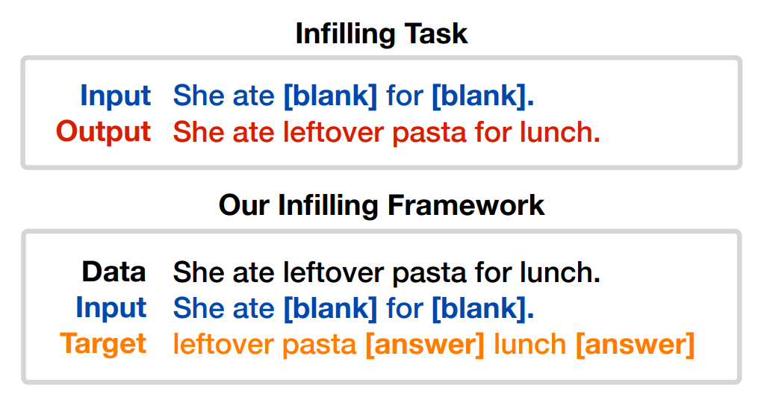
Text Infilling Enabling Language Models to Fill in the Blanks
This framework prevents the model from having to predict unmasked text.
Significant drop in number of tokens to be predicted by avoiding redundancy hence making this framework efficient.

Slide 5
Text Infilling
Data: ["Cameron's Coffee Single Serve Pods, Flavored, Chocolate Caramel Brownie, 12 Count (Pack of 1)",
{'Brand': "Cameron's Coffee", 'Item form': 'Single Serve Pods',
'Specialty': 'Flavored', 'Net content': '12 Count'} ]
Input: Cameron's Coffee Single Serve Pods, Flavored, Chocolate Caramel Brownie, 12 Count (Pack of 1) : Brand is
[mask] and Item form is [mask] and Specialty is [mask] and Net content is [mask]
Target: Cameron’s Coffee[answer]Single Serve Pods[answer]Flavored[answer]12 Count[answer]

Slide 6
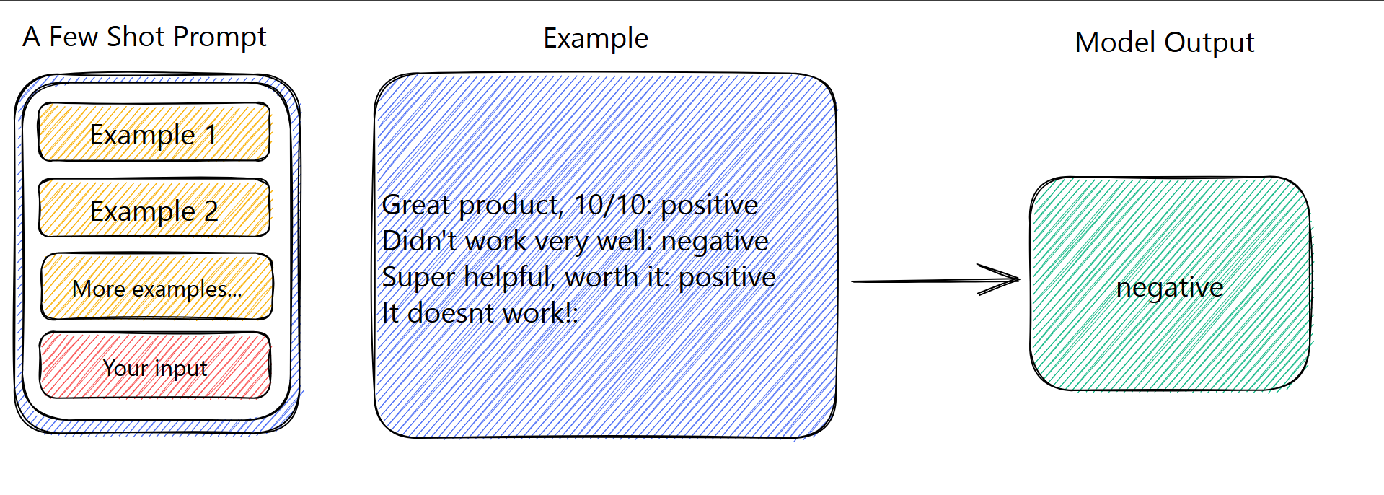
Baseline
The LLaMa-3.1-8B-Instruct model was used with few-shot prompting as baseline. 3 examples were given in each prompt.

Slide 7
Baseline
Prior methods like SuoTag and BiLSTM-CRF lack general world understanding unlike modern LLMs like LLaMa, hence comparison with these methods is not fair.
Span-based models can only extract a single attribute value at a time for a given attribute from a product title, whereas methods using LLM’s allow all attributes to be processed simultaneously, significantly reducing computational overhead.
The LLaMa-3.1-8B-Instruct model is suitable for baseline and comparative analysis.

Slide 8
Exploring Results
The exploration results aim to evaluate two critical aspects of model performance
• Robustness: The model’s ability to maintain consistent performance across diverse scenarios, including both frequent and rare cases. By testing the model across these extremes, we ensure that its performance is not biased towards any specific subset of data.
• Versatility: The model’s capacity to generalize effectively across different datasets and attribute types. The versatility evaluation ensures that the model is not overly specialized, making it suitable for real-world applications involving diverse data sources.

Slide 9
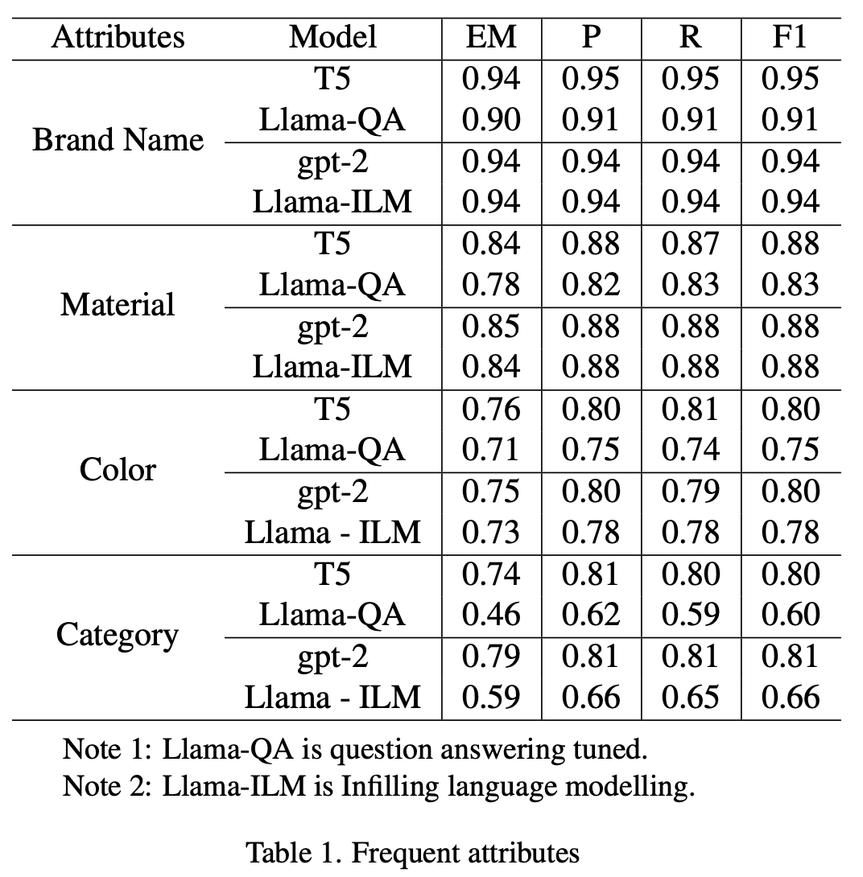
Robustness (freq attributes)
-> When comparing the ILM training paradigm and Question Answering (QA) fine-tuning the F1 scores are nearly identical.ILM shows a slight advantage over QA fine-tuning.
-> Even with minimal training and the use of a quantized model fine-tuned with Quantized LoRA at rank 8 (adding only 20M parameters), the results are highly competitive.The scores closely match those of T5 and GPT-2 models reported in the original paper.

Slide 10
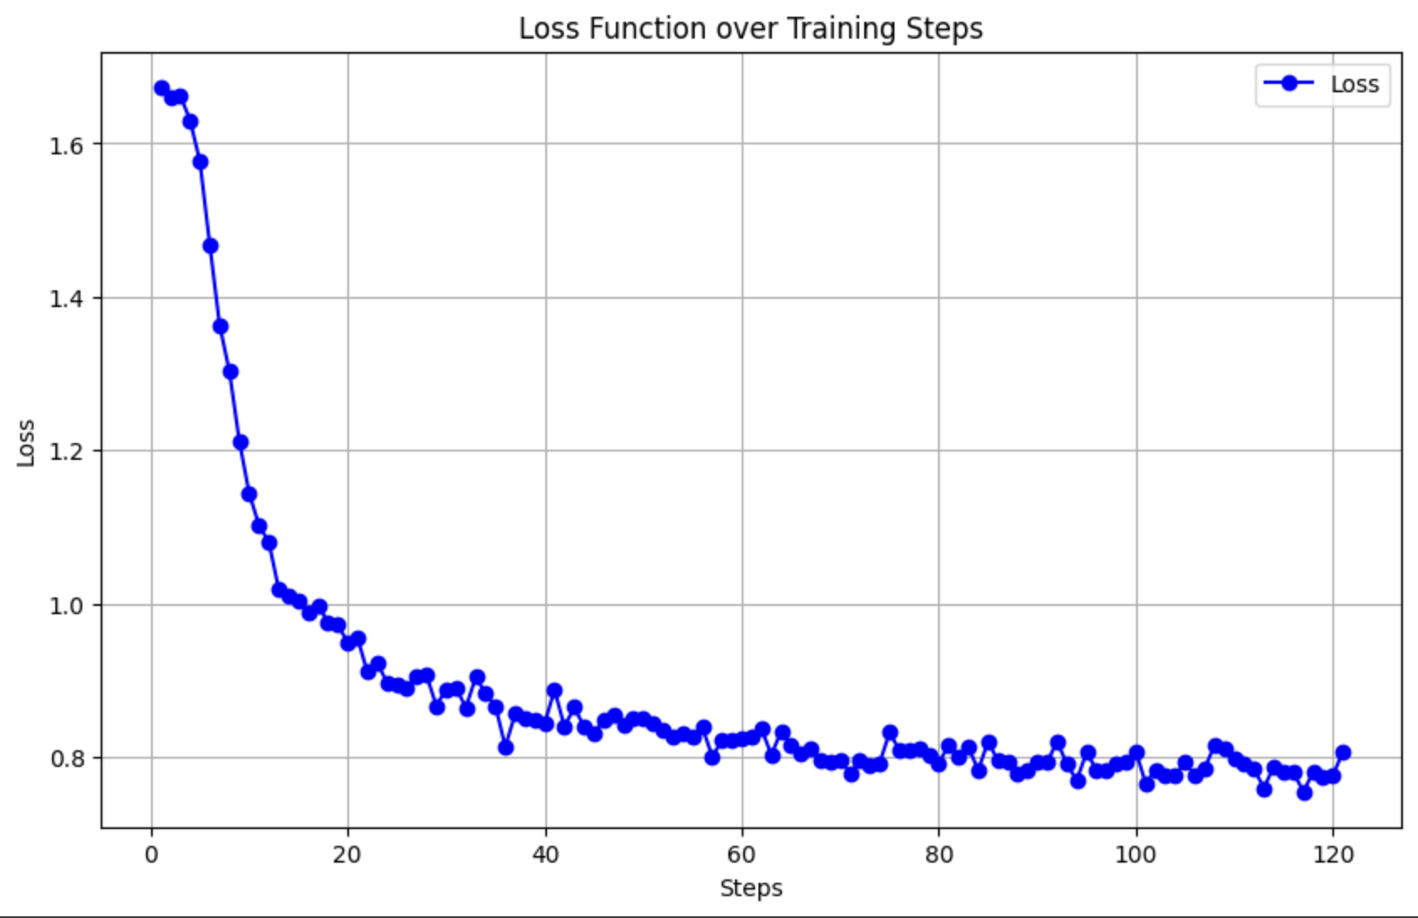
Robustness (freq attributes)
-> Possible Explanation : In QA fine-tuning, the loss reduction might result more from optimizing the output prompt structure(i.e since we are giving the attributes in input and the output also contains attributes in json the model might learn to reduce loss on that) rather than improving the accuracy of output predictions.
Key Limitation in Comparison efficiency:
-> The original paper does not explicitly outline the fine-tuning methodology (full parameter, Lora etc..), leading to potential variations and interpretative challenges when comparing efficiency.

Slide 11
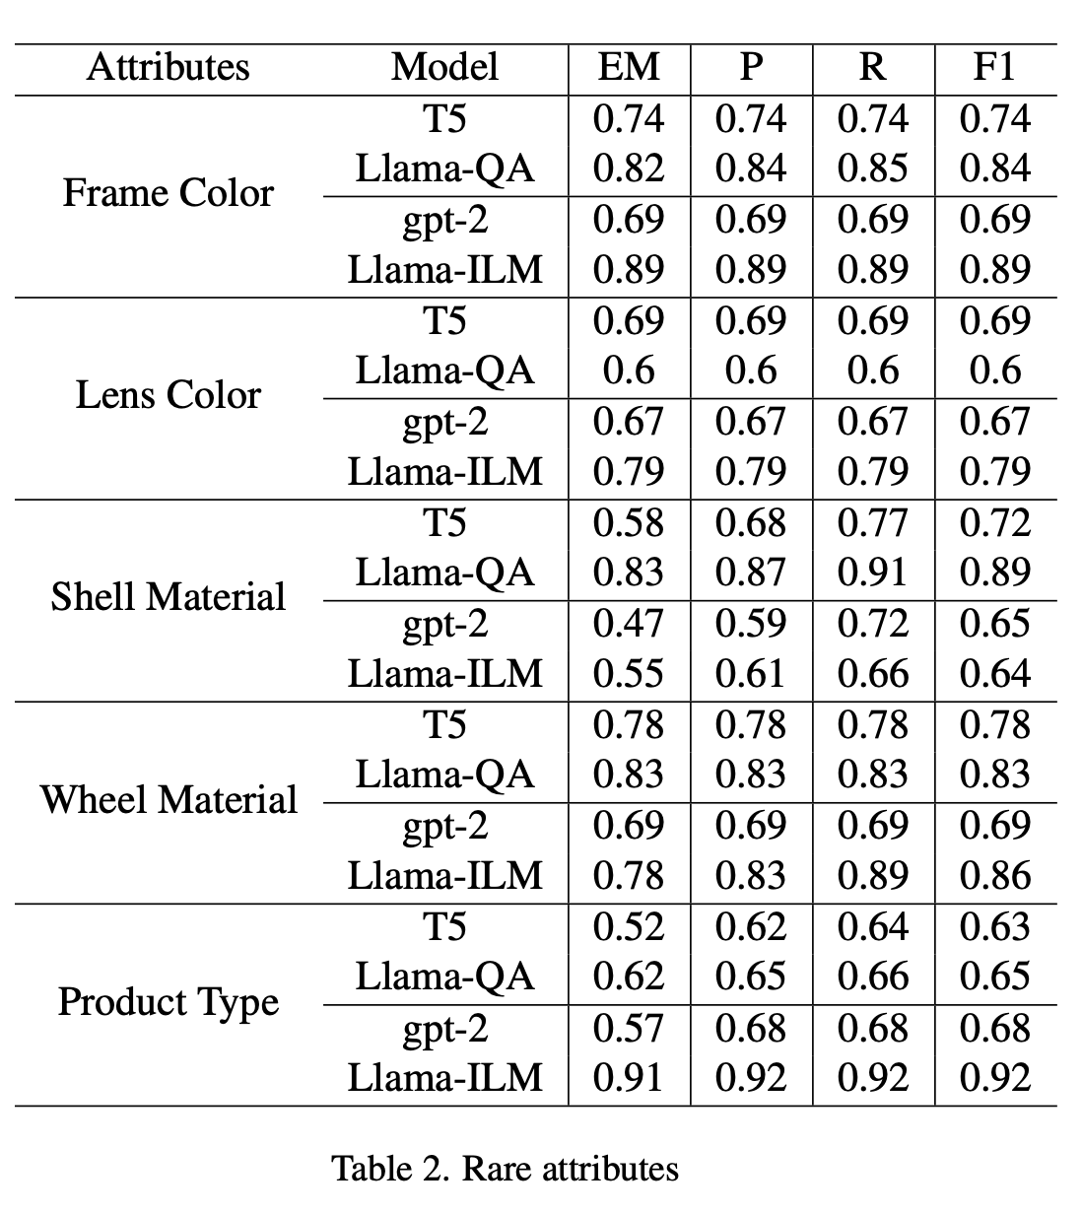
Robustness (rare attributes)
Performance on Rare Attributes:
-> Both LLaMA-ILM and LLaMA-QA outperform T5 and GPT-2 on rare attributes, showcasing their superior handling of such cases.
Role of General Knowledge:
-> Success with rare attributes depends heavily on the model’s pre-trained general knowledge, as fine-tuning encounters fewer examples of these attributes.

Slide 12
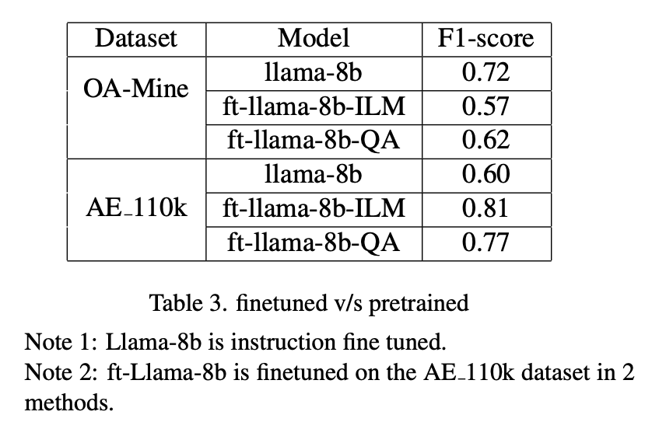
Versatility
OA_MINE :
-> Generalization Trade-Off the instruct model outperforms fine-tuned models, indicating that fine-tuning may weaken the model’s generalization capabilities.
AE_110k :
->Dataset-Specific Performance, fine-tuned models achieve significantly higher F1 scores, demonstrating that fine-tuning can greatly improve performance for specific datasets.

Slide 13
Conclusions
Advantage of ILM Paradigm:
-> The ILM paradigm is more efficient than QA fine-tuning, requiring fewer tokens and lower compute for training and inference, without compromising performance.
Efficiency of Smaller LLM fine tuning:
-> Unlike the resource-intensive fine-tuning of GPT-3.5 and GPT-4 used in Extract GPT, smaller LLMs with QLoRA achieve significant gains with a simpler training process, making dataset-specific fine-tuning preferable over using a generalized model.

